Slide 1
Improvement of the S-101 Portrayal (Report of the ENC Display Sub Working Group)
- Activities since ENCWG2 (March 2017, Genoa, Italy) - Main portrayal issues
Hydrographic Services and Standards Committee

Slide 2
Brief history of the ENC Display Sub WG (ENCD-SWG)
Paper S-100WG2-11.7_ENC_Display_Issues.pdf submitted by France at S-100WG2, ENCWG2 (March 2017) and NCWG2 (May 2017).
Creation of the ENCD-SWG (led by France – Christian Mouden).
Welcomed by HSSC9 (Nov. 2017) which placed it under the ENCWG (Decision – HSSC9/14).
Creation of a Basecamp (May 2017) to share file and discussions.
22 organizations:
13 Hydrographic Offices (Australia, Brazil, Canada, France, Denmark, Estonia, Finland, Italy, Japan, Korea, Norway, UK, USA);
IHO Secretariat;
2 RENCs: IC-ENC, PRIMAR;
3 OEMs: Furuno, Sevenc’s, Transas;
3 Expert Contributors: IALA, IIC Technologies, Geomod.
Basecamp open to voluntary participants (contact: christian.mouden@shom.fr)

Slide 3
Activities
Screenshots (S-52 PL 4.0.2) and comments collected until 10 March 2018.
All issues and comments gathered in an XLS sheet.
XLS sheet was the base for paper ENCWG3-5.1: "Improvement of ENCs display on ECDIS”. (https://www.iho.int/mtg_docs/com_wg/ENCWG/ENCWG3/ENCWG3-5.1_ENC%20Display%20SubWG.pdf)
Issues that could only be solved in S-101 have been excluded from the paper.

Slide 4
Decisions for ENCD-SWG
ENCWG3 agreed for:
New edition of the S-57 UOC (improvement of the encoding for a better display).
No changes to the S-52 Presentation Library.
What for S-101 Portrayal?
Changes limited to the issues identified?
Global review of the portrayal?
What is the S-101PT view?
What is the mariner’s view?

Slide 5
Issue “ENC Content”
ENC and paper chart are definitely 2 different products.
ENC content should be ≠ from paper chart content (“ENC First” scenario)
→ Where and how should this be explained (S-101 DCEG, S-4?)
Are the production tools ready for this split in content?
Need for ECDIS view in the production tools.
IS THERE A NEED FOR INSTRUCTIONS IN TERMS OF S-101 ENC CONTENT?

Slide 6
Issue “Scale Minimum” (1/4)
FACTS:
Current IHO SCAMIN table does not fully prevent screen clutter;
Different rules between HOs (regional approach);
Need for manual population of Scale Minimum based on case by case study? (very time consuming);
Scale Minimum steps are currently defined for a single ENC but not within a portfolio.

Slide 7
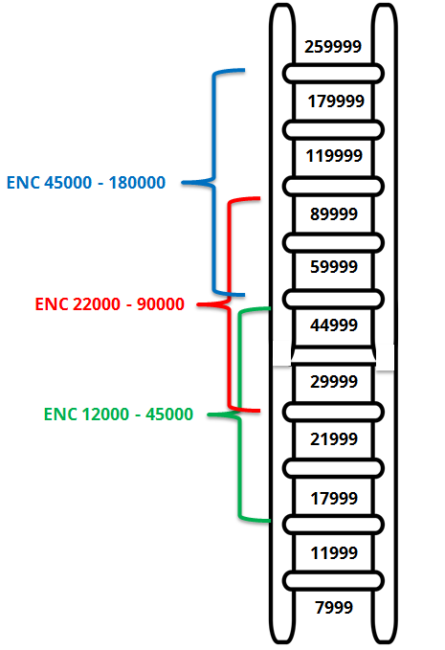
Issue “Scale Minimum” (2/4)
CURRENT S-101 RULE:
S-101 Scale minimum table is a copy of S-57 UOC.
Basic rule: at MSVS, the larger scale ENC has the higher priority.
Example: at MSVS 45000, the ENC with Maximum display Scale = 12000 has the highest priority,
But Scale minimum will be Step 4!

Slide 8
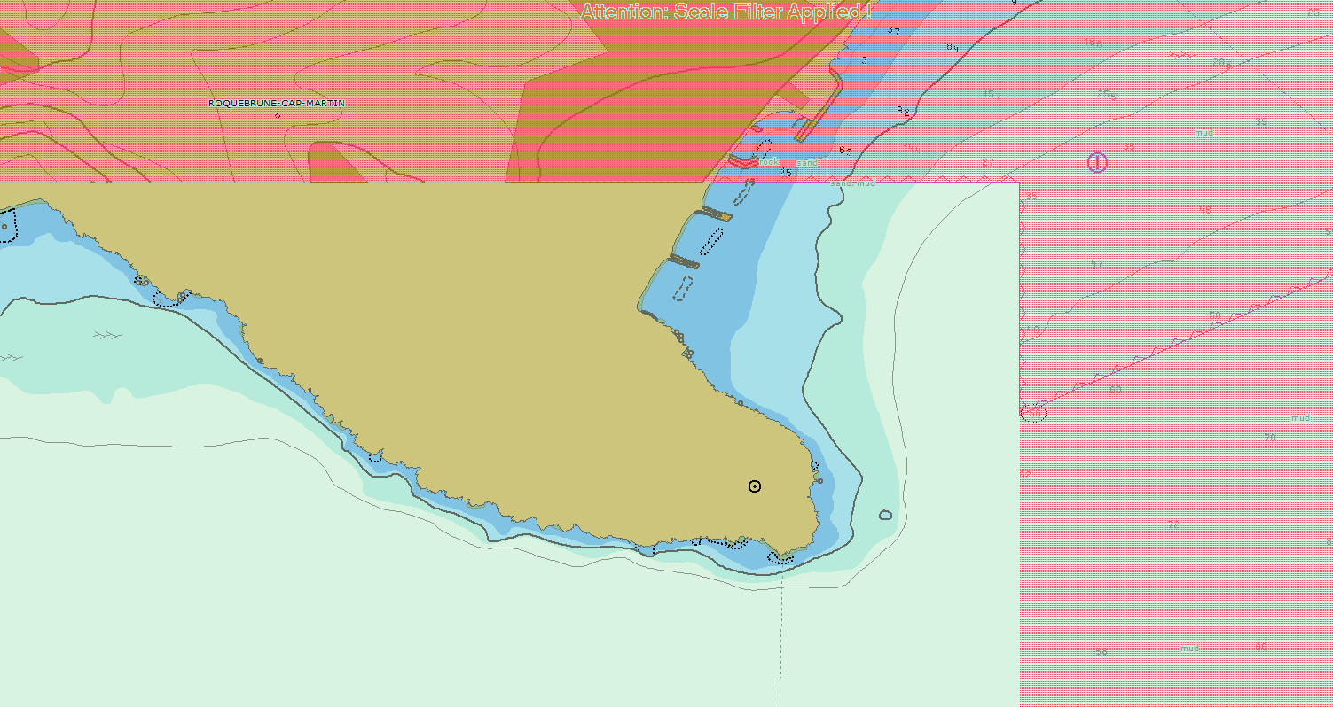
Issue “Scale Minimum” (3/4): Example
MSVS = 14000
Largest Scale ENC has a higher priority but shows less information as Scale Minimun is applied (Step 3)
ENC 12000 - 45000
ENC 4000 - 22000

Slide 9
Issue “Scale Minimum” (4/4)
SUGGESTIONS:
Shouldn’t we have more Scale Minimum steps for a more progressive cartography?
Scale Minimum steps could be reviewed in the spirit of a portfolio, but not a single ENC.
Other improvements are possible.
DO WE PLAN A FULL REVIEW OF SCALE MINIMUM TABLE FOR S-101?

Slide 10
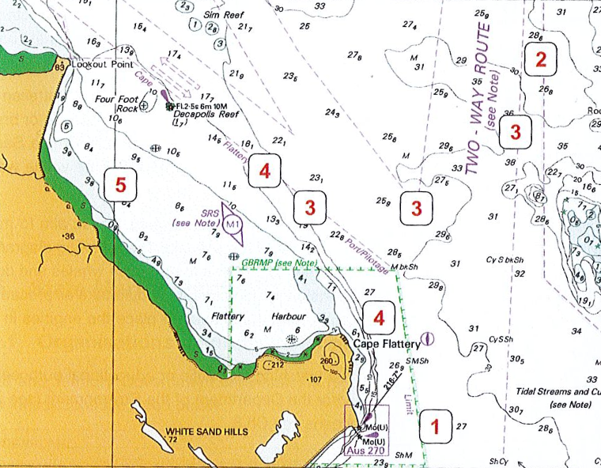
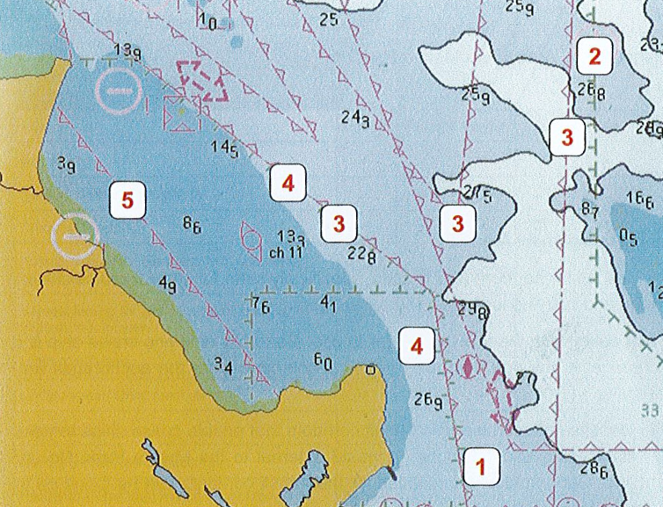
Other issues: area limits symbology
It is very difficult to identify the different areas on the ENC.

Slide 11
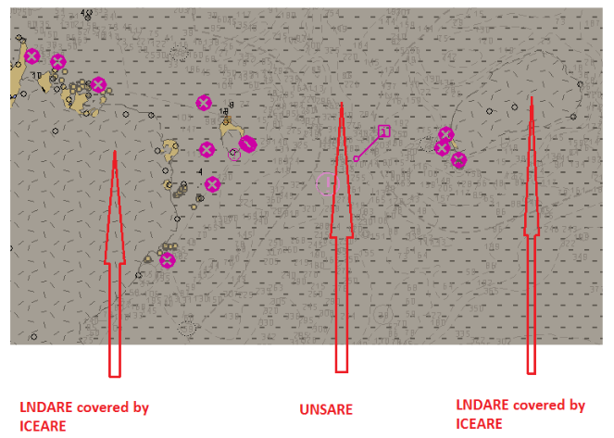
Other issues: UNSARE and ICEARE
Very difficult to distinguish between ICEARE and UNSARE.
DEPCNT and SOUNDG are hardly visible within UNSARE

Slide 12
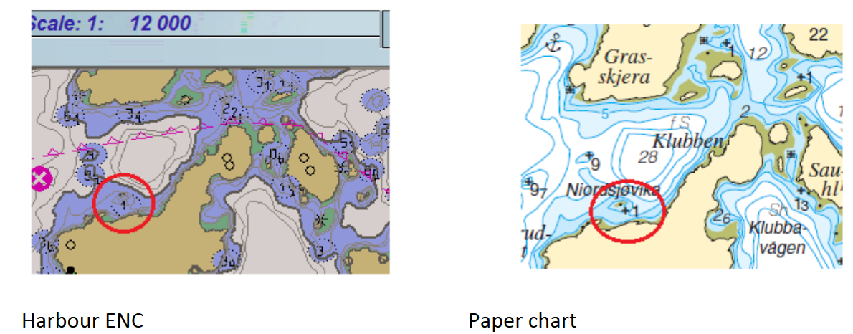
Other issues: Display priorities
It has been identified that some objects may cover another one which is more dangerous.
Here, UWTROC with VALSOU=1 covers Point LNDARE.
DISPLAY PRIORITIES SHOULD BE REVIEWED/IMPROVED

Slide 13
Other issues: short (non-exhaustive) list
“No display” objects: there is a number of objects that do not display in S-52. This must be solved in S-101.
Names: “Text placement” is an important improvement, but is it enough to avoid text overlappings?
Symbology in general: S-52 was elaborated in the late 1980s and was supposed to be reviewed. ENC display is sometimes viewed as “old fashioned”. See KHOA presentation for what future S-101 ENC could look like.

Slide 14
Actions required from S-101PT
Note this presentation.
Discuss the issues identified in this presentation.
Decide (or refer to HSSC?) the scope of the changes to be considered for the S-101 portrayal.
Decide how the improvements to the S-101 portrayal should be organized between S-101PT, NCWG and the ENC Display Sub WG.

Slide 15
ANY QUESTIONS?
THANK YOU
Any questions?

